Slide 1


VAZHIKAATTI – A CAREER GUIDANCE PROGRAM FOR ASPIRING CA’S
THE INSTITUTE OF CHARTERED ACCOUNTANTS OF INDIA

Slide 2
General Instructions This slide can be deleted before presentation
Start with the real story of a CA from that area preferably from a Government aided school
And finish the ppt with what they are doing now and how successful they are

Slide 3
CAREER GOALS
Economic well- being
Reputation
International exposure
Good social stature
Attractive career options
Dedicated professional
CA student

Slide 4
OPTIONS AVAILABLE
Engineering or Medicine
Arts and Sciences
Law and Others
Chartered Accountancy

Slide 5
What is a CA ?

Slide 6
THE IMPORTANCE AND IMPACT OF CA AS A PROFESSION
A CA’s Pen is mightier than a Sword
As Finance Professionals - Finance is the back bone of any enterprise and CA’s enable the same in Accounting , Reporting and Control roles
As Auditors - There is no Second Opinion on a CA’s opinion on a financial statement
7 Continents.. 1 Language
Accountancy

Slide 7
ICAI Partner in Nation Building
Chartered Accountants help in the financial health of enterprises
Shareholders
Government
Notes:
Creating financial awareness by conducting the investor awareness programs for general public.. encouraging people to explore investment opportunities that offer tax benefits and safety; enable the public to understand the economic policies, budgets placed in the state assemblies and Lok Sabha and Rajya Sabhas, explain the new schemes that are launched by the government in the various sectors, Offering suggestions and also representing the views, grievances of public clients and fraternity to the government. Ensuring compliances so that revenue of government is not eroded etc.

Slide 8
Who enables the CA Course in India

Slide 9

ICAI – Excellence | Independence | Integrity
THE INSTITUTE OF CHARTERED ACCOUNTANTS OF INDIA
A statutory body established in India by an Act of Parliament
“The Chartered Accountants Act,1949”
ICAI is the 2nd largest Accounting Body in the World.
Notes:
AICPA IS THE FIRST LARGEST ACCOUNTING BODY

Slide 10

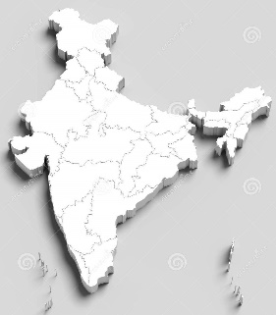




How big is ICAI
Human Resources # 931
Branches # 167
Foreign Chapters # 44
Branch Own Buildings # 100
Auditoriums
#40 & Seminar Halls
# 95 (Approximate capacity # 20897+)
Information Technology Centres
# 162 (Computers # 6530 Plus)
350000 CA’s and 10 lakh students – 40% are women

Slide 11
ADMINISTRATION
Central Council
Five Regional Councils
Northern India Regional Council
Southern India Regional Council
Eastern India Regional Council
Western India Regional Council
Central India Regional Council

Slide 12
SOUTHERN INDIA REGIONAL COUNCIL
Tamil Nadu
Karnataka
Kerala
Andhra Pradesh
Telangana
Pondicherry
Each Branch and Region is headed by a team of Chartered Accountants

Slide 13
BRANCHES IN TAMIL NADU
BRANCHES | JURISDICTION
SIRC of ICAI- CHENNAI-Regional Council | Chennai, Thiruvallur & all other places not covered by branches
Chengalpattu | Chengalpattu Kanchipuram
Coimbatore | Coimbatore Nilgiris
Erode | Erode
Kumbakonam | Mayiladuthurai Nagapattinam Thanjavur Tiruvarur Kumbakonam
Madurai | Dindigul Madurai Ramanathapuram Sivaganga Theni
Salem | Dharmapuri Krishnagiri Namakkal Salem
Sivakasi | Virudhu Nagar; Sivakasi
Tiruchirapalli | Ariyalur Karur Perambalur Pudukkottai Tiruchirappalli
Tirunelveli | Tenkasi Tirunelveli
Tirupur | Tirupur
Thoothukudi | Tuticorin
Vellore | Ranipet Tirupathur Tiruvannamalai

Slide 14
What can a CA do after passing the Course

Slide 15
AFTER BECOMING A CA
Own Practice | Job /Employment
Entrepreneurship / Business | Further Studies/ UPSC/Management
Can also be elected to the offices of Branch , Regional and Central Council of ICAI
Notes:
While presenting the interim budget of 2020-21, CA. Piyush Goyal, Hon’ble Minister for Railways and also given additional charge for Ministry of Finance said “We are poised to become a 5 trillion dollar economy in the next 5 years and aspire to become a 10 trillion dollar economy in the next 8 years” thereby implying that the role of Chartered Accountants is only going to get more important from here on and there could be a dearth of about 25000 professionals in the market in the future.

Slide 16
ROLES OF A CA
Any School completion / College Degree
Auditor
Management Consultancy services
CHARTERED ACCOUNTANT
Information Technology consulting
Business
Advisory services
Government
Advanced finance and economics
Academics
Notes:
Information Technology Consulting: In the field of employment also CA s offer great support in creating flow

Slide 17
What is the CA Course all about

Slide 18
Levels
Foundation
Intermediate
Final Exams

Slide 19
CA COURSE – 3 LEVELS AT A GLANCE
FOUNDATION (LEVEL 1)
FEES-Rs. 9200
CAN REGISTER ANY TIME AFTER PASSING 10TH STANDARD EXAMS
APPEAR FOR CA FOUNDATION EXAMS AFTER WRITING 12TH STD EXAMS
INTERMEDIATE (LEVEL 2)
FEES Rs. 18000
STUDY PERIOD 9 MONTHS
ARTICLESHIP AFTER PASSING ONE OR BOTH GROUPS
FINAL
(LEVEL-3)
FEES – Rs.22000
BECOME A MEMBER
AFTER 2.5 YEARS OF ARTICLESHIP
4 PAPERS
8 PAPERS
8 PAPERS
May undergo revision

Slide 20

USP of CA profession
Regulator of audit and assurance functions
Open for all streams: Commerce/Arts/Science
EARN WHILE YOU EARN
Offers opportunities for distance learning
Age is no bar (As in any age, anyone can register in CA Course)
Equal opportunity for all
Meritocracy
Standardized course with regular updates
Cloud campus for students
Campus placement
Employment (Attractive career options)
Ability to multitask
Great learning at minimal cost

Slide 21
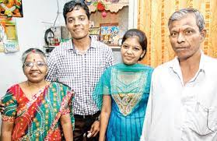
IS IT DIFFICULT TO PASS CA
HARDWORK
DEDICATION
CHARTERED ACCOUNTANT

Slide 22
PASS PERCENTAGE OF CA FINAL
Particulars | Number of candidates appeared | Pass percentage
Group I | 65291 | 21.39%
Group II | 64775 | 18.61%
Both Groups | 29242 | 11.09%

Slide 23
What do I have to Study

Slide 24
Levels
Foundation
Intermediate
Final Exams

Slide 25
Subjects in the CA Foundation course
PAPER-1 Principles and Practices of Accounting
PAPER-2
BUSINESS LAWS BUSINESS CORRESPONDENCE AND REPORTING
PAPER-3 BUSINESS MATHS STATISTICS LOGICAL REAONING
PAPER-4 BUSINESS ECONOMICS BUSINESS COMMERCIAL KNOWLEDGE

Slide 26
EXAM TIMELINES FOR FOUNDATION COURSE
FOR MAY EXAMS LAST DATE OF COURSE REGISTRATION JAN 1ST OF EVERY YEAR
FOR NOVEMBER EXAMS LAST DATE OF COURSE REGISTRATION JULY 1ST OF EVERY YEAR
BASIC CONDITION- MINIMUM 4 MONTHS FROM THE TIME OF REGISTERING FOR CA FOUNDATION COURSE

Slide 27
Intermediate course
Intermediate Course
Paper-1: Accounting.
Paper-2: Corporate and Other Laws.
Paper-3: Cost and Management Accounting.
Paper-4: Taxation.
Paper-5: Advanced Accounting.
Paper-6: Auditing and Assurance.
Paper-7: Enterprise Information Systems & Strategic Management.
Paper-8: Financial Management and Economics for Finance
Group-1
Group-2
May undergo revision

Slide 28
FINAL COURSE
Groups | Papers | Details
Group 1 | Paper-1 | Financial Reporting
 | Paper-2 | Strategic Financial Management
 | Paper-3 | Advanced Auditing and Professional Ethics
 | Paper-4 | Corporate and Economic Laws
Group 2 | Paper-5 | Strategic Cost Management and Performance Evaluation
 | Paper-6 | Paper-6A: Risk Management Paper-6B: Financial Services and Capital Markets Paper-6C: International Taxation Paper-6D: Economic Laws Paper-6E: Global Financial Reporting Standards Paper-6F: Multidisciplinary Case Study
 | Paper-7 | Direct Tax Laws and International Taxation
 | Paper-8 | Indirect Tax Laws
May undergo revision

Slide 29
FOR MATERIAL DOWNLOADS EVEN BEFORE REGISTRATION
https://boslive.icai.org/index.php

Slide 30
What is Articleship

Slide 31
ARTICLESHIP TRAINING
UNDER A PRACTICING CHARTERED ACCOUNTANT
ELIGIBLE FOR STIPEND
PERIOD OF ARTICLESHIP
MINIMUM 18 MONTHS
MAXIMUM 36 MONTHS
OPTION OF INDUSTRIAL TRAINING
IF A STUDENT COMPLETES BOTH GROUPS OF INTERMEDIATE
STIPEND ON COMPANY TO COMPANY BASIS

Slide 32
Earn while you Learn (Minimum stipend)
Stipend to Articled Assistants
 | Classification of the normal place of service of the articled assistants | Stipend payable per month (₹) during training
 |  | First year | Second year | Third year | Total Stipend for Three Years
1. | Cities/Towns having population of 20 lakh and above | 2, 000 | 2, 500 | 3, 000 | 90,000
2. | Cities/Towns having population of 4 lakh and above but less than 20 lakh | 1, 500 | 2, 000 | 2, 500 | 72, 000
3. | Cities/Towns having population of less than 4 lakh | 1, 000 | 1, 500 | 2, 000 | 54, 000
Many firms pay a larger stipend. This is the minimum rate

Slide 33
What else will I learn during CA other than exam syllabus

Slide 34
Skill based compulsory courses
ICITSS COURSE-1
PARTICULARS | HOURS/ DAYS | TIMELINES | MANDATORY CLAUSE | FEES
COURSE ON INFORMATION TECHNOLOGY | 100 HOURS | AFTER COMPLETING 1 GROUP OR BOTH GROUPS OF CA INTERMEDIATE EXAMS | COMPULSORY FOR JOINING ARTICLESHIP | 6500
ORIENTATION PROGRAM |  | PART OF ICITSS-1 | SAME | 7000
 |  |  | MUST PASS THE inf tech EXAMS WITH MINIMUM OF 60% and attendance of 90% and above

Slide 35
Skill based compulsory courses- contd
ADVANCED AICTSS COURSE
PARTICULARS | HOURS/ DAY | TIMELINES | MANDATORY CLAUSE | FEES [IN RS]
ADVANCED MANAGEMENT AND COMMUNICATION SKILLS COURSE | 4 WEEKS | IN THE 2ND OR 3RD YEAR OF ARTICLESHIP AFTER COMPLETING INTERMEDIATE BOTH GROUPS | TO COMPLETE BEFORE APPEARING FOR FINAL COURSE | 7000
ADVANCED COURSE ON INFORMATION TECHNOLOGY | SAME | SAME | MUST PASS THE EXAMS AND HAVE 90% ATTENDANCE | 7500
PRACTICAL TRAINING TEST |  | 1ST AND 2ND YEAR OF ARTICLESHIP | HOME BASED- PASSING MUST | NIL

Slide 36
Who will teach me ?

Slide 37
PHYSICAL COACHING CLASSES
ALL THE REGIONAL COUNCILS AND BRANCHES CONDUCT AFFORDABLE AND QUALITY COACHING CLASSES FOR IN PHYSICAL AND VIRTUAL MODE
STUDENTS WHO HAVE STUDIED FROM 6TH STD IN A GOVERNMENT SCHOOL AND ACADEMICALLY BRILLIANT BUT FROM POOR ECONOMIC BACKGROUND CAN AVAIL THE FREE SIRC COACHING CLASSES AFTER THEY REGISTER FOR CA COURSE

Slide 38
24
ICAI’s Virtual Classes, e-Learnings and Cloud Campus facilities
LIVE VIRTUAL CLASSES https://boslive.icai.org/index.php
SOCIAL MEDIA PLATFORMS FOR UPDATES TWITTER TELEGRAM KOO APP LINKEDIN FACEBOOK INSTAGRAM YOUTUBE
1
2
DIGITAL LEARNING HUB https://learning.icai.org/elearning
CLOUD CAMPUS https://cloudcampus.icai.org/
3
4

Slide 39
I Finished passing CA.

Slide 40
AFTER BECOMING A CA
Own Practice | Job /Employment
Entrepreneurship / Business | Further Studies/ UPSC/Management
Can also be elected to the offices of Branch , Regional and Central Council of ICAI
Notes:
While presenting the interim budget of 2020-21, CA. Piyush Goyal, Hon’ble Minister for Railways and also given additional charge for Ministry of Finance said “We are poised to become a 5 trillion dollar economy in the next 5 years and aspire to become a 10 trillion dollar economy in the next 8 years” thereby implying that the role of Chartered Accountants is only going to get more important from here on and there could be a dearth of about 25000 professionals in the market in the future.

Slide 41
Campus Placement

Slide 42
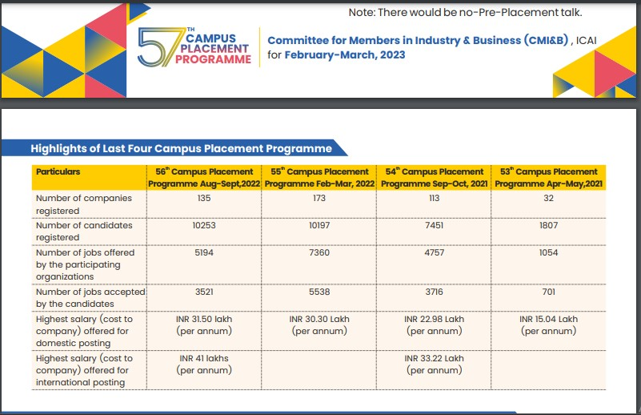
CAMPUS PLACEMENT JAN-FEB 2023

Slide 43
Any Financial Assistance

Slide 44
SCHOLARSHIPS
MERIT BASED SCHOLARSHIPS FOR INTERMEDIATE AND FINAL STUDENTS
NEED BASED SCHOLARSHIP FOR CA INTEREMEDIATE AND CA FINAL STUDENTS

Slide 45
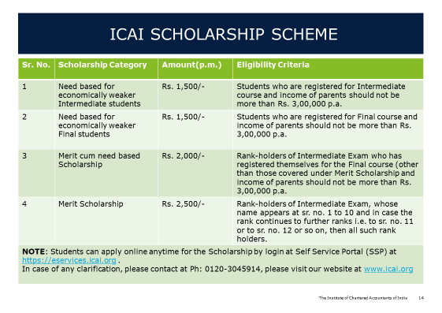

Slide 46
Is CA course only Study

Slide 47
FOR STUDENTS
ARTICLESHIP IS A GREAT EXPERIENCE
SICASA
STUDENTS SKILL ENRICHMENT BOARD
EDUCATIONAL TOURS
YOUTH FESTIVALS
PAPER PRESENTATIONS IN NATIONAL CONFERENCES
NATIONAL LEVEL COMPETITIONS FOR CA STUDENTS

Slide 48
Can I Work Abroad

Slide 49
OPPORTUNITIES ABROAD
MUTUAL RECOGNITION AGREEMENTS
Institute of Chartered Accountants of Nepal
Malaysian institute of Certified Public Accountants
Institute of Chartered Accountants of England and Wales
Chartered Professional Accountants of Canada
Certified Public Accountants of Ireland
South African Institute of Chartered Accountants
Certified Practicing Accountants –Australia
Singapore

Slide 50
Can I Study More

Slide 51
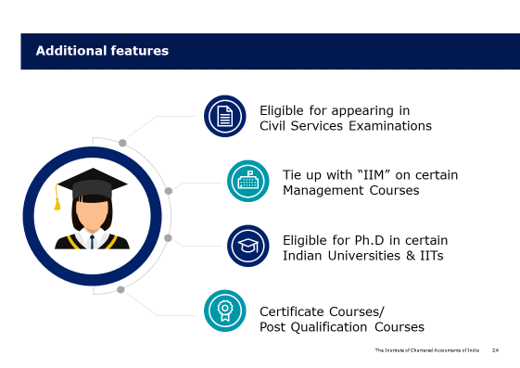
31

Slide 52
I want to think about doing CA

Slide 53
CONTACTS DOWNLOADS AND WEBSITES
ICAI NEW DELHI | https://www.icai.org/
 | TOLL FREE: 7877966966
SIRC OF ICAI | https://www.sirc-icai.org/
 | 30210300/30210359/30210352
BRANCHES IN TAMILNADU | https://www.sirc-icai.org/sirc-of-icai-in-tamilnadu.php
DOWNLOAD PROSPECTUS | https://resource.cdn.icai.org/45785bos35964.pdf

Slide 54
JUST A CALL AWAY
sirccounselling@icai.in or sircdean@icai.in
04430210364/323/370/379

Slide 55
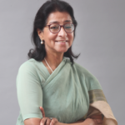
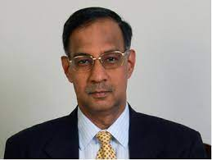
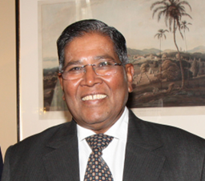
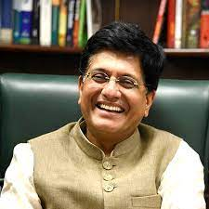
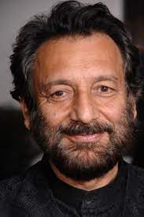
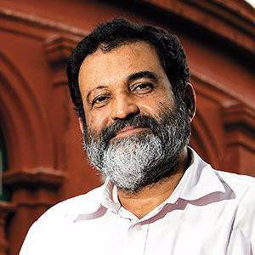
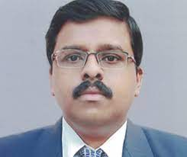
R Seshasayee
Naina Lal Kidwai
CA Rahman Khan
Shekar Kapur
Film Maker
CA Piyush Goyal
Mohandas Pai
Kirlosh Kumar IAS

Slide 56
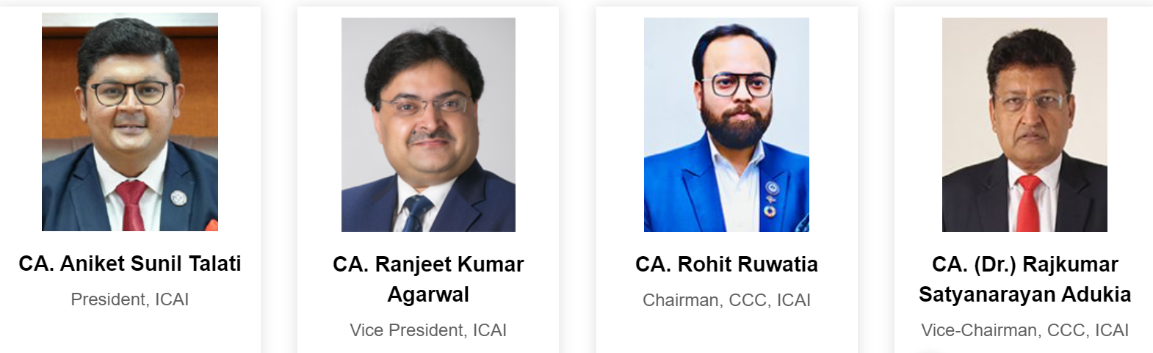
Career Counselling Committee of ICAI

